Slide 1
LECTURE FIVE
PLANNING AND BUDGETING
Notes:
Chapter 8: Profit Planning
This chapter focuses on the steps taken by businesses to achieve their planned levels of profits - a process called profit planning. Profit planning is accomplished by preparing numerous budgets, which, when brought together, form an integrated business plan known as a master budget.

Slide 2
In this lecture, the focus will be on the steps taken by businesses to achieve their planned levels of profits.
This process is called Profit Planning.

Slide 3
Learning Objective 1
Understand why organizations budget and the processes they use to create budgets.
Notes:
Learning objective number 1 is to understand why organizations budget and the processes they use to create budgets.

Slide 4
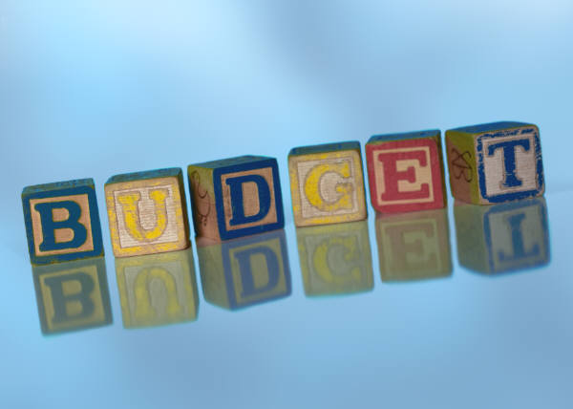
The Basic Framework of Budgeting
A budget is a detailed quantitative plan for acquiring and using financial and other resources over a specified forthcoming time period.
Managers use budgeting as an effective cost-management tool.
Budgets facilitate planning and coordination.
Notes:
A budget is a detailed quantitative plan for acquiring and using financial and other resources over a specified forthcoming time period. The act of preparing a budget is called budgeting. The use of budgets to control an organization’s activities is known as budgetary control.

Slide 5
Budgets are used for two distinct purposes:
Planning and Control

Slide 6


Planning and Control
Planning –
involves developing objectives and preparing various budgets to achieve those objectives.
Control –
involves the steps taken by management to increase the likelihood that the objectives set down while planning are attained and that all parts of the organization are working together toward that goal.
Notes:
Planning involves developing objectives and preparing various budgets to achieve those objectives.
Control involves the steps taken by management to increase the likelihood that the objectives set down at the planning stage are attained and that all parts of the organization are working together toward that goal.
To be effective, a good budgeting system must provide for both planning and control. Good planning without effective control is time wasted.

Slide 7
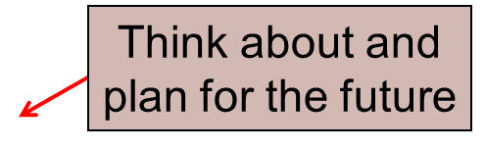
Advantages of Budgeting
Define goals
and objectives
Communicate
plans
Advantages
Coordinate
activities
Means of allocating
resources
Uncover potential
bottlenecks
Notes:
Budgets communicate management’s plans throughout the organization. Budgets force managers to think about and plan for the future. The budgeting process provides a means of allocating resources to those parts of the organization where they can be used most effectively. The budget process can uncover potential bottlenecks before they occur. Budgets coordinate the activities of the entire organization by integrating the plans of its various parts. Budgets define goals and objectives that can serve as benchmarks for evaluating subsequent performance.
While our focus in this chapter is on preparing operating budgets for a one-year time frame, longer term budgets also can be very helpful to organizations from a planning standpoint.

Slide 8
Behavioral Issues in Budgeting
Budgetary slack is the “cushion” managers intentionally build into budgets to help ensure success in meeting the budget (by underestimating revenues or overestimating expenses)
Spending the budget is another issue; managers often feel if they do not use all the resources they receive, next year’s budget may be cut
10-<number>

Slide 9
Behavioral Issues in Budgeting (continued)
  Linkage of compensation and budgeted performance:
  Difficulty level of the budget target?
    An easy budget may fail to encourage employees to give their best efforts, while a very difficult target can discourage managers from even trying
    A “highly achievable target” is suggested with incentives for exceeding the budgeted figures
10-<number>

Slide 10
Behavioral Issues in Budgeting (continued)
  Authoritative or participative budgeting?
    Top-down budgeting is referred to as authoritative budgeting
    Imposing budgets from above with little participation and then penalizing employees who do not meet those expectations will generate anger rather than cooperation and commitment.
    Bottom-up budgeting is referred to as participative budgeting(self imposed)
    Effective budgeting processes often combine the two types
10-<number>

Slide 11
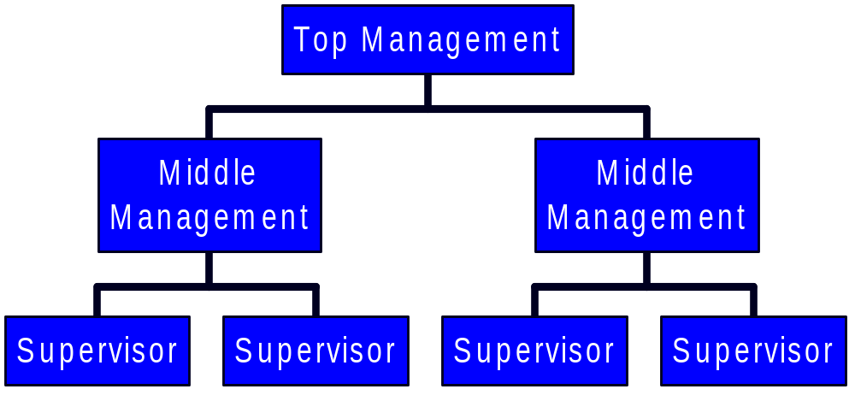
Self-Imposed Budget
A self-imposed budget or participative budget is a budget that is prepared with the full cooperation and participation of managers at all levels.
Notes:
A self-imposed budget or participative budget is a budget that is prepared with the full cooperation and participation of managers at all levels. It is a particularly useful approach if the budget will be used to evaluate managerial performance.

Slide 12

Self-Imposed Budgets
Self-imposed budgets should be reviewed by higher levels of management to prevent “budgetary slack.”
Most companies issue broad guidelines in terms of overall profits or sales.
Lower-level managers are directed to prepare budgets that meet those targets.
Notes:
Self-imposed budgets should be reviewed by higher levels of management. Without such a review, self-imposed budgets may have too much “budgetary slack,” or may not be aligned with overall strategic objectives. Most companies do not rely exclusively upon self-imposed budgets in the sense that top managers usually initiate the budget process by issuing broad guidelines in terms of overall target profits or sales. Lower level managers are directed to prepare budgets that meet those targets.

Slide 13
Possible Human Relations Problems
Learning
Objective 2
Problems in implementing budgets:
- Low level of participation in the budget process,
- Lack of acceptance of responsibility for the
final budget,
- Difficulties in obtaining accurate sales
forecasts
Notes:
Three problems that can limit, in some cases severely, the advantages of budgeting:
1. Low levels of participation in the budget process and lack of acceptance of responsibility for the final budget
2. Incentives to lie and cheat in the budget process
3. Difficulties in obtaining accurate sales forecasts

Slide 14
Budgeting Process Overview
Budget Committee
Budget Period
Budget Guidelines
Negotiation, Review, and Approval
Revision
10-<number>

Slide 15

The Budget Committee
A standing committee responsible for
  overall policy matters relating to the budget
  coordinating the preparation of the budget
  resolving disputes related to the budget
  approving the final budget
Notes:
A budget committee is usually responsible for overall policy relating to the budget program, for coordinating the preparation of the budget, for resolving disputes related to the budget, and for approving the final budget. This committee may consist of the president and the vice presidents in charge of various functions such as sales, production, purchasing, and the controller.

Slide 16
The Master Budget
Represents the “grand plan of action” for an upcoming period
Translates the organization’s short-term objectives into action steps
Culminates in the preparation of a set of pro-forma financial statements
Communicates to employees and managers alike the expectations of top management
Helps coordinate subunit activities
10-<number>

Slide 17




Master Budget
Learning
Objective 5
The master budget
is a detailed and
comprehensive analysis
of the first year of the
long-range plan.
It summarizes the
planned activities
of all subunits of
an organization.
Notes:
The master budget is a detailed and comprehensive analysis of the first year of the long-range plan. It quantifies targets for sales, purchases, production, distribution, and financing in the form of forecasted financial statements and supporting operating schedules.

Slide 18
Master Budget
Learning
Objective 5
The master budget
is a detailed and
comprehensive analysis
of the first year of the
long-range plan.
It summarizes the
planned activities
of all subunits of
an organization.
Notes:
The master budget is a detailed and comprehensive analysis of the first year of the long-range plan. It quantifies targets for sales, purchases, production, distribution, and financing in the form of forecasted financial statements and supporting operating schedules.

Slide 19
Master Budget
Operating budget
(profit plan). . .
Financial budget. . .
Focuses on the income statement and supporting schedules or budgeted expenses.
Focuses on the effects that the operating budget and other plans will have on cash balances.
Notes:
The two major parts of a master budget are the operating budget and the financial budget. The operating budget—sometimes called the profit plan—focuses on the income statement and its supporting schedules or, in an organization with no sales revenues, on budgeted expenses and supporting schedules. In contrast, the financial budget focuses on the effects that the operating budget and other plans (such as capital budgets and repayments of debt) will have on cash balances.
The distinction between the operating budget and the financial budget is important because of the distinction between profitability and financial position. There are many examples of firms with strong profits where a weak cash position placed them in bankruptcy. There are also many examples of firms whose strong financial position allowed them to survive periods of temporary unprofitability.

Slide 20
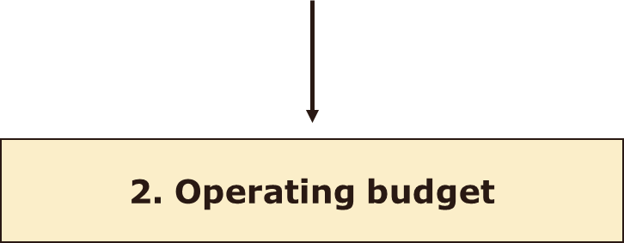
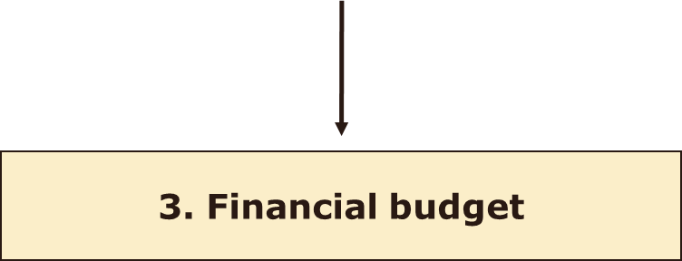
Steps in Preparing the Master Budget
Learning
Objective 6
1. Supporting data
Notes:
The principal steps in preparing the master budget are as follows:
1. Supporting Budgets and Schedules
2. Operating Budget
3. Financial Budget

Slide 21
Steps in Preparing the Master Budget
The principal steps in preparing
the master budget:
1. Basic data
a. Sales budget
b. Cash collections from customers
c. Purchases and cost-of-goods sold budget
d. Cash disbursements for purchases
e. Operating expense budget
f. Cash disbursements for operating expenses
Notes:
Basic data
a. Sales budget
b. Cash collections from customers
c. Purchases and cost-of-goods sold budget
d. Cash disbursements for purchases
e. Operating expense budget
f. Cash disbursements for operating expenses

Slide 22
Steps in Preparing the Master Budget
2. Operating Budget:
Prepare budgeted income
statement using basic data in step 1.
3. Financial Budget: Prepare forecasted
financial statements:
a. Capital budget
b. Cash budget
c. Budgeted balance sheet
Notes:
Operating Budget
Prepare budgeted income statement using basic data in step 1.
Financial Budget
Prepare forecasted financial statements:
a. Capital budget
b. Cash budget
c. Budgeted balance sheet

Slide 23

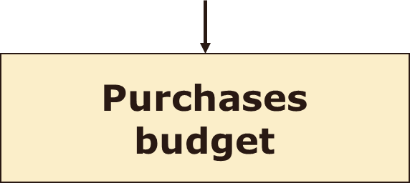

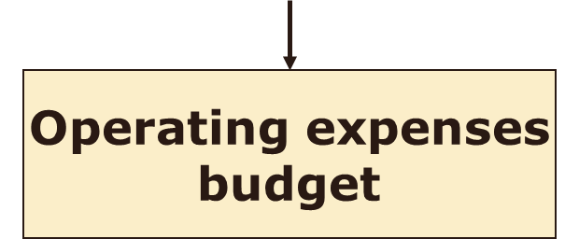
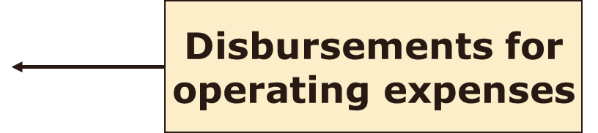
Operating Budget
Learning
Objective 7
Sales
budget
Notes:
The sales budget is the starting point for budgeting because planned inventory levels, purchases, and operating expenses all depend on the expected level of sales. Schedule b uses the sales budget to plan when CHC will collect cash. In turn, we will use Schedule b to prepare the cash budget in Step 3. Cash collections from customers include the current month’s cash sales plus collection of the previous month’s credit sales.
The elements of the purchases budget are tied together by a simple intuitive identity that ignores minor complications such as returns and defects but relates the fundamental uses of inventory to the sources: Inventory is either sold or else carried over to the next period as ending inventory. Inventory comes from either beginning inventory or purchases. Month-to-month changes in sales volume and other cost-driver activities directly influence many operating expenses. Examples of expenses driven by sales volume include sales commissions and delivery expenses—these are included in miscellaneous expenses for CHC.

Slide 24
Cash Collections
It is easiest to prepare budgeted
cash collections at the same
time as the sales budget.
Cash collections include
the current month’s cash
sales plus the previous
month’s credit sales.
Notes:
It is easiest to prepare budgeted cash collections at the same time as the sales budget. Cash collections include the current month’s cash sales plus the previous month’s credit sales.

Slide 25
Purchases Budget and Cash Disbursements
Budget cost of goods sold by multiplying the cost of
merchandise sold percentage
by budgeted sales.
The total merchandise needed
is the sum of budgeted cost
of goods sold plus the desired ending inventory.
Notes:
Budget cost of goods sold by multiplying the cost of merchandise sold percentage (70%) by budgeted sales. The total merchandise needed is the sum of budgeted cost of goods sold plus the desired ending inventory.

Slide 26
Purchases Budget and Cash Disbursements
Finally, compute required purchases by subtracting beginning inventory from total merchandise needed:
Budgeted purchases:
= Desired ending inventory
+ Cost of goods sold
– Beginning inventory
Purchases
Use the budgeted purchases to budget cash disbursements.
Notes:
Finally, we compute required purchases by subtracting beginning inventory from the total merchandise needed: Budgeted purchases = Desired ending inventory + Cost of goods sold – Beginning inventory

Slide 27
Preparing Individual Budgets (e.g., a Sales Budget)
Three-step process:
Define the “bottom-line” information contained in the budget (e.g., sales for the upcoming period)
Determine what this information is a function of (e.g., the sales budget = a function of budgeted unit sales and budgeted selling price/unit)
Put together information in a user-friendly way
10-<number>

Slide 28
The Master Budget: An Overview
Sales budget
Selling and
administrative
budget
Ending inventory
budget
Production budget
Direct materials
budget
Direct labor
budget
Manufacturing
overhead budget
Cash Budget
Budgeted
income
statement
Budgeted
balance sheet
Notes:
The master budget consists of a number of separate but interdependent budgets. We have developed this schematic of the budgeting process to illustrate the interdependency of the various individual budgets. The sales budget shows the expected sales for the budget period expressed in dollars and units. It is usually based on a company’s sales forecast. All other parts of the master budget are dependent on the sales budget.
The production budget is prepared after the sales budget. It lists the number of units that must be produced during each budget period to meet sales needs and to provide for the desired ending inventory. The production budget in turn directly influences the direct materials, direct labor, and manufacturing overhead budgets, which in turn enable the preparation of the ending finished goods inventory budget. These budgets are then combined with data from the sales budget and the selling and administrative expense budget to determine the cash budget. The cash budget is a detailed plan showing how cash resources will be acquired and used over a specified time period. All of the operating budgets have an impact on the cash budget.
The last step of the process is to prepare a budgeted income statement and a budgeted balance sheet.

Slide 29
Learning Objective 2
Prepare a sales budget, including a schedule of expected cash collections.
Notes:
Learning objective number 2 is to prepare a sales budget, including a schedule of expected cash collections.

Slide 30
Budgeting Example
Royal Company is preparing budgets for the
quarter ending June 30th.
Budgeted sales for the next five months are:
  April 20,000 units
  May 50,000 units
  June 30,000 units
  July 25,000 units
  August 15,000 units
The selling price is $10 per unit.
Notes:
The marketing department of Royal Company prepares the following information that will be used to prepare a budget for the quarter ending June 30th.

Slide 31

Factors to Consider When Forecasting Sales
General
economic
conditions
Estimates made
by sales force
Past patterns
of sales
Competitors’
actions
Market
research
studies
Changes in the
firm’s prices
Advertising
and sales
promotion plans
Changes in
product mix
Notes:
1. Past patterns of sales: Past experience combined with detailed past sales by product line, geographic region, and type of customer can help predict future sales.
2. Estimates made by the sales force: A company’s sales force is often the best source of information about the desires and plans of customers.
3. General economic conditions: The financial press regularly publishes predictions for many economic indicators, such as gross domestic product and industrial production indexes (local and foreign). Knowledge of how sales relate to these indicators can aid sales forecasting.
4. Competitors’ actions: Sales depend on the strength and actions of competitors. To forecast sales, a company should consider the likely strategies and reactions of competitors, such as changes in their prices, product quality, or services.
5. Changes in the firm’s prices: A company should consider the effects of planned price changes on customer demand (see Chapter 5). Normally, lower prices increase unit sales while higher prices decrease unit sales.
6. Changes in product mix: Changing the mix of products often can affect not only sales levels but also overall contribution margin. Identifying the most profitable products and devising methods to increase their sales is a key part of successful management.
7. Market research studies: Some companies hire marketing experts to gather information about market conditions and customer preferences. Such information is useful to managers making sales forecasts and product-mix decisions.
8. Advertising and sales promotion plans: Advertising and other promotional costs affect sales levels. A sales forecast should be based on anticipated effects of promotional activities.

Slide 32
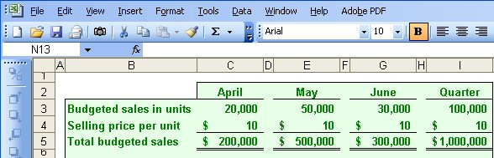
The Sales Budget
The individual months of April, May, and June are summed to obtain the total budgeted sales in units and dollars for the quarter ended June 30th
Notes:
Royal sells only one product and that product has a selling price of $10 per unit. To calculate the total sales in dollars for any period, we multiply the budgeted sales in units times the unit selling price. As you can see, Royal forecasts unit sales of 100,000 and total sales revenue of $1,000,000 for the quarter ended June 30th.
Once we complete the sales budget, we can move on to the expected cash collections from sales.

Slide 33
Expected Cash Collections
All sales are on account.
Royal’s collection pattern is:
  70% collected in the month of sale,
  25% collected in the month following sale,
  5% uncollectible.
In April, the March 31st accounts receivable balance of $30,000 will be collected in full.
Notes:
All sales at Royal are made on account. The company collects 70 percent of the sales revenue in the month of sale, 25 percent in the following month, and estimates that 5 percent of all credit sales will prove uncollectible.
At the start of the quarter, Royal had $30,000 in accounts receivable that were deemed to be fully collectible.
Let’s prepare the budget of expected cash collections on sales.

Slide 34
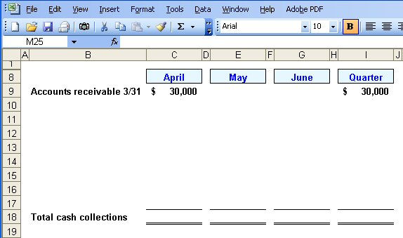
Expected Cash Collections
Notes:
The first step in calculating Royal’s cash collections is to insert the March 31st beginning accounts receivable, $30,000, into the April column of the cash collections schedule. This balance will be collected in full in April.

Slide 35
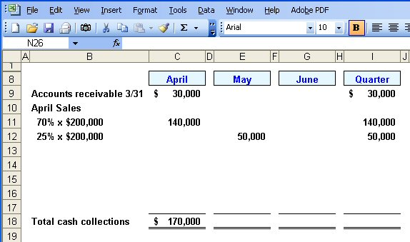
Expected Cash Collections
From the Sales Budget for April.
Notes:
The second step is to calculate the April credit sales that will be collected during each month of the quarter. We will collect another $140,000 ($200,000 times 70 percent) in April. In addition, 25% of April projected sales will be collected in May, so $50,000 of April sales will be collected in May. Finally, 5 percent of April’s sales will prove to be uncollectible. This amounts to $10,000 ($200,000 times 5 percent).

Slide 36
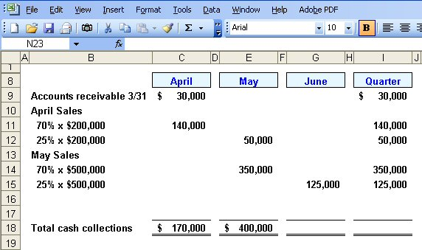
Expected Cash Collections
From the Sales Budget for May.
Notes:
The third step is to calculate the May credit sales that will be collected during each month of the quarter. We will collect $350,000 ($500,000 times 70 percent) in the month of May and an additional 25 percent of the $500,000 will be collected in June. Finally, 5 percent of May’s sales will prove to be uncollectible. The uncollectible amount will be $25,000 ($500,000 times 5 percent).
Can you complete the final month of June to get the total expected cash collections for the quarter?

Slide 37

Quick Check ✓
What will be the total cash collections for the quarter?
  a. $700,000
  b. $220,000
  c. $190,000
  d. $905,000
Notes:
Take your time and remember that we are asking for the total cash collections for the quarter ended June 30th.

Slide 38
Quick Check ✓
What will be the total cash collections for the quarter?
  a. $700,000
  b. $220,000
  c. $190,000
  d. $905,000
Notes:
How did you do? We will show you the computations on the next screen.

Slide 39
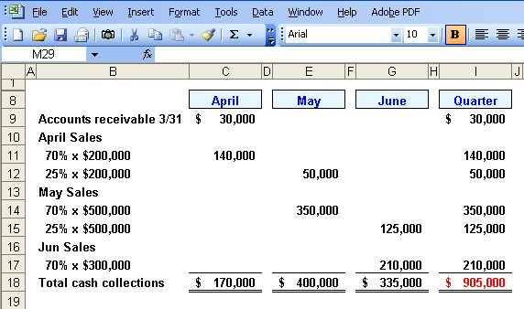
Expected Cash Collections
Notes:
The fourth step is to calculate the June credit sales that will be collected during the month of June. We expect to collect $210,000 ($300,000 times 70 percent) from June sales in the month of June.
The fifth step is to calculate the total for each column in the schedule and the total for the quarter ($905,000).
Now let’s turn our attention to the production budget.

Slide 40
Learning Objective 3
Prepare a production budget.
Notes:
Learning objective number 3 is to prepare a production budget.

Slide 41

The Production Budget
Sales
Budget
and
Expected
Cash
Collections
Production
Budget
Completed
The production budget must be adequate to
meet budgeted sales and to provide for
the desired ending inventory.
Notes:
After we have budgeted our sales and expected cash collection, we must make sure the production budget is adequate to meet the forecasted sales and to provide for the desired ending inventory. We need inventory on hand at the end of the period to minimize the likelihood of an inventory stock-out.

Slide 42
The Production Budget
The management at Royal Company wants ending inventory to be equal to 20% of the following month’s budgeted sales in units.
On March 31st, 4,000 units were on hand.
Let’s prepare the production budget.
Notes:
The management at Royal wants to minimize the probability of a stock out of inventory items. A policy has been implemented that requires the company to maintain ending inventory of 20 percent of the following month’s budgeted sales. At the beginning of the quarter, Royal had 4,000 units in inventory. If Royal was a merchandising company it would prepare a merchandise purchases budget instead of a production budget.
Let’s get started on the production budget.

Slide 43
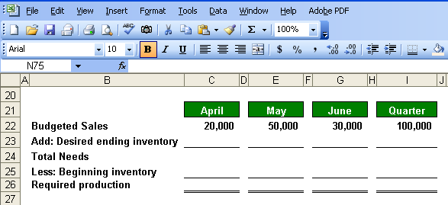
The Production Budget
Notes:
The first step in preparing the production budget is to insert the budgeted sales in units from the sales budget.

Slide 44
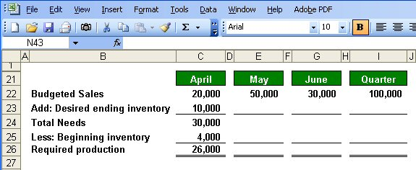
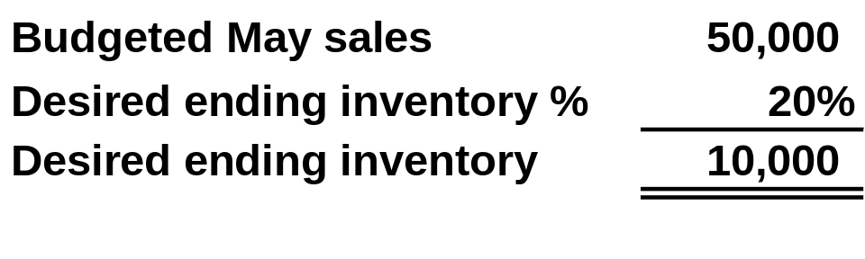
The Production Budget
March 31
ending inventory.
Notes:
The second step is to calculate the required production in units for April (26,000 units). Notice, the desired ending inventory in units for April (10,000 units) and the beginning inventory in units for April (4,000 units).

Slide 45
Quick Check ✓
What is the required production for May?
  a. 56,000 units
  b. 46,000 units
  c. 62,000 units
  d. 52,000 units
Notes:
What did you calculate as the required production for May?

Slide 46
Quick Check ✓
What is the required production for May?
  a. 56,000 units
  b. 46,000 units
  c. 62,000 units
  d. 52,000 units
Notes:
The correct answer is 46,000 units. We will show you the calculation of this amount on the next screen.

Slide 47
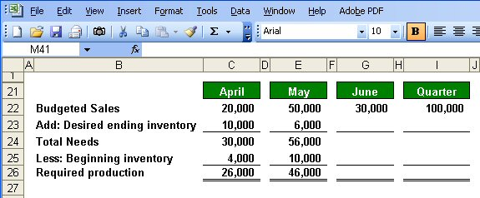
The Production Budget
Notes:
The third step is to calculate the required production for May (46,000 units). Notice, April’s desired ending inventory (10,000 units) becomes May’s beginning inventory.

Slide 48
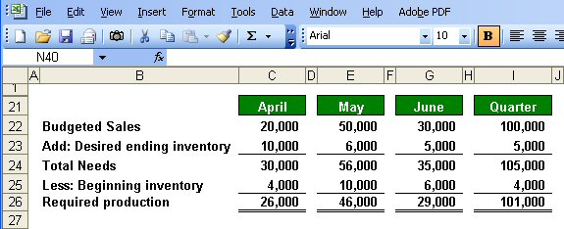

The Production Budget
Assumed ending inventory.
Notes:
The fourth step is to calculate the required production for June (29,000 units). Notice, we are assuming a desired ending inventory of 5,000 units. This implies that projected sales in July are 25,000 units because 20 percent of 25,000 units is 5,000 units.
The fifth step is to complete the Quarter columns. Notice, April’s beginning inventory and June’s ending inventory are carried over to the column. For the quarter, we will need to produce 101,000 units to meet our sales and inventory goals. Now that we know our required production, let’s look at the direct materials budget.

Slide 49
Learning Objective 4
Prepare a direct materials budget, including a schedule of expected cash disbursements for purchases of materials.
Notes:
Learning objective number 4 is to prepare a direct materials budget, including a schedule of expected cash disbursements for purchases of materials.

Slide 50
The Direct Materials Budget
At Royal Company, five pounds of material are required per unit of product.
Management wants materials on hand at the end of each month equal to 10% of the following month’s production.
On March 31, 13,000 pounds of material are on hand. Material cost is $0.40 per pound.
Let’s prepare the direct materials budget.
Notes:
Each good unit of output requires 5 pounds of direct material. Management does not want to run out of direct materials, so a policy has been established that materials on hand at the end of each month must be equal to 10% of the following month’s production. At the beginning of the month, Royal has 13,000 pounds of direct material on hand. Each pound of direct material costs $0.40.
Let’s complete the direct materials budget.

Slide 51
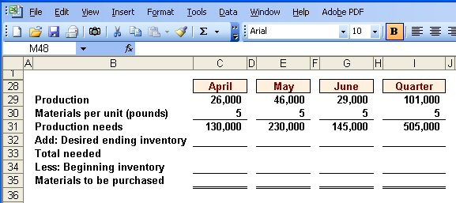
The Direct Materials Budget
From production budget.
Notes:
The first step in preparing the direct materials budget is to insert the required production in units from the production budget.

Slide 52
The Direct Materials Budget
Notes:
The second step is to calculate the monthly and quarterly production needs, which in this case are stated in terms of pounds of direct material.

Slide 53
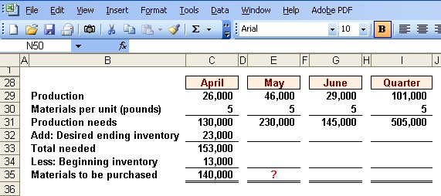
The Direct Materials Budget
March 31 inventory.
10% of following month’s production needs.
Calculate the materials to
be purchased in May.
Notes:
The third step is to calculate the materials to be purchased for April (140,000 pounds).
April’s desired ending inventory is equal to 10% of May’s production needs, or 23,000 pounds. The total number of pounds needed in April is 153,000 pounds.
Finally, we subtract our materials on hand to determine the number of pounds of material that must be purchased. During April, Royal must purchase 140,000 pounds of direct materials.

Slide 54
Quick Check ✓
How much materials should be purchased in May?
  a. 221,500 pounds
  b. 240,000 pounds
  c. 230,000 pounds
  d. 211,500 pounds
Notes:
Refer back to the previous slide and determine how much materials should be purchased in May.

Slide 55
Quick Check ✓
How much materials should be purchased in May?
  a. 221,500 pounds
  b. 240,000 pounds
  c. 230,000 pounds
  d. 211,500 pounds
Notes:
The correct answer is 221,500 pounds. Let’s see how we got this value.

Slide 56
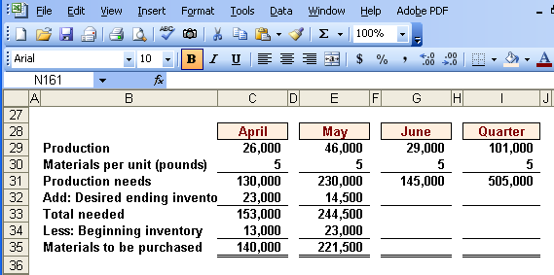
The Direct Materials Budget
Notes:
The fourth step is to calculate the materials to be purchased for May (221,500 pounds). Notice that April’s desired ending inventory becomes May’s beginning inventory. May’s desired ending inventory is 10% of June’s production needs of 145,000 pounds.

Slide 57
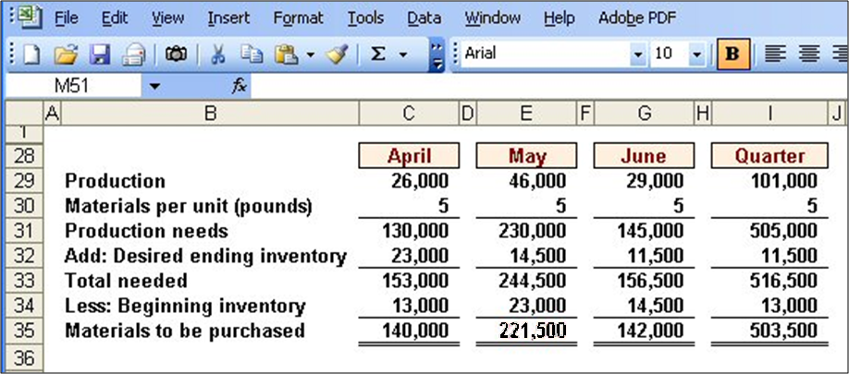
The Direct Materials Budget
Assumed ending inventory.
Notes:
The fifth step is to calculate the materials to be purchased for June (142,000 pounds). The desired ending inventory for May becomes the beginning inventory for June. We are assuming a desired ending inventory for June of 11,500 pounds. April’s beginning inventory and June’s ending inventory carry over to the quarter columns.

Slide 58
Expected Cash Disbursement for Materials
Royal pays $0.40 per pound for its materials.
One-half of a month’s purchases is paid for in the month of purchase; the other half is paid in the following month.
The March 31 accounts payable balance is $12,000.
Let’s calculate expected cash disbursements.
Notes:
Recall that Royal pays $0.40 per pound of direct materials. The company pays for one-half of its purchases in the month of the purchase and one-half in the following month. At the beginning of the quarter, Royal owed creditors $12,000 for purchases of direct materials.
Let’s begin the expected cash disbursement for direct materials schedule.

Slide 59
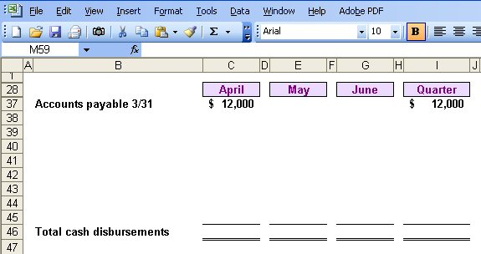
Expected Cash Disbursement for Materials
Notes:
The first step in calculating Royal’s cash disbursements is to insert the beginning accounts payable balance ($12,000) into the April column of the cash disbursements schedule. This balance will be paid in full in April.

Slide 60
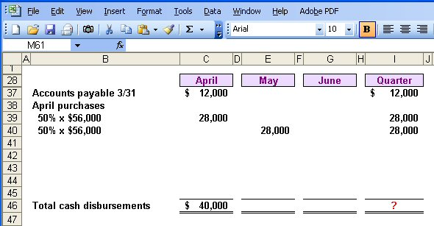
Expected Cash Disbursement for Materials
Compute the expected cash
disbursements for materials
for the quarter.
140,000 lbs. × $0.40/lb. = $56,000
Notes:
The second step is to calculate the April credit purchases that will be paid during each month of the quarter. In April $28,000 ($56,000 x 50%) will be paid in April and $28,000 will be paid in May. The $56,000 is derived by multiplying 140,000 pounds by the $0.40 per pound purchase price. Now it is time for you to go to work. See if you can complete the expected cash disbursements for materials for the quarter.
Please complete the schedule for the quarter and see how your work is progressing.

Slide 61
Quick Check ✓
What are the total cash disbursements for the quarter?
  a. $185,000
  b. $ 68,000
  c. $ 56,000
  d. $201,400
Notes:
Which answer did you get for total cash disbursements for the quarter?

Slide 62
Quick Check ✓
What are the total cash disbursements for the quarter?
  a. $185,000
  b. $ 68,000
  c. $ 56,000
  d. $201,400
Notes:
The correct answer is $185,000. Let’s look at the completed schedule to see how we arrived at this answer.

Slide 63
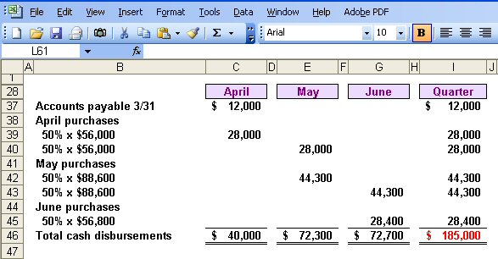
Expected Cash Disbursement for Materials
Notes:
The remaining steps include calculating the May and June credit purchases that are paid during each month of the quarter. We also calculate the totals for all columns in the schedule and the total for the quarter ($185,000).
Now let’s move to the direct labor budget.

Slide 64
Learning Objective 5
Prepare a direct labor budget.
Notes:
Learning objective number 5 is to prepare a direct labor budget.

Slide 65
The Direct Labor Budget
At Royal, each unit of product requires 0.05 hours (3 minutes) of direct labor.
The Company has a “no layoff” policy so all employees will be paid for 40 hours of work each week.
For purposes of our illustration assume that Royal has a “no layoff” policy, workers are paid at the rate of $10 per hour regardless of the hours worked.
For the next three months, the direct labor workforce will be paid for a minimum of 1,500 hours per month.
Let’s prepare the direct labor budget.
Notes:
Carefully review the information on the screen. A unique aspect of direct labor at Royal is the no overtime policy. The company agrees to no layoffs of employees if work is slow, but in return, pays its employees straight time at $10 per hour for all hours worked. With the current work force, Royal will have to pay for a minimum of 1,500 hours of direct labor regardless of the work available.
Let’s prepare this budget.

Slide 66
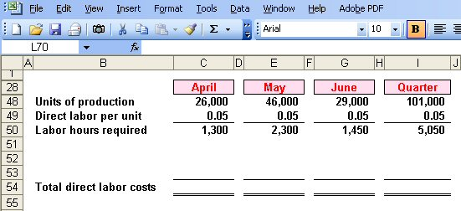
The Direct Labor Budget
From production budget.
Notes:
The first step in preparing the direct labor budget is to insert the production in units from the production budget.

Slide 67
The Direct Labor Budget
Notes:
The second step is to compute the direct labor hours required to meet the production needs. Remember each unit of output requires 0.05 direct labor hour. We will require 1,300 direct labor hours in April, 2,300 direct labor hours in May, and 1,450 direct labor hours in June.

Slide 68
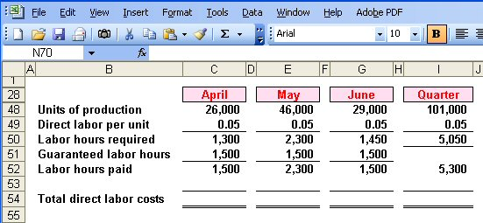
The Direct Labor Budget
Greater of labor hours required
or labor hours guaranteed.
Notes:
Because of the no layoff policy, Royal is committed to paying for a minimum of 1,500 hours per month. The third step, in this example, is to compute the direct labor hours paid each month and for the quarter. The number of hours paid will be the greater of the direct labor hours required, or 1,500 hours.
In April, Royal will pay for 1,500 direct labor hours when there is only work for 1,300 hours. In May, Royal will pay for 2,300 direct labor hours, and the company will pay for 1,500 hours in June. For the quarter, the company will pay for 5,300 direct labor hours.

Slide 69
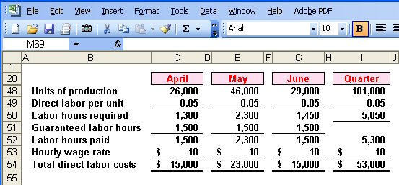
The Direct Labor Budget
Notes:
The fourth step is to compute the total direct labor cost. Based on the $10 per hour rate, Royal will pay $15,000 for direct labor in April, $23,000 in May, and $15,000 in June, for a total of $53,000 for the quarter.

Slide 70
Quick Check ✓
What would be the total direct labor cost for the quarter if the company follows its no lay-off policy, but pays $15 (time-and-a-half) for every hour worked in excess of 1,500 hours in a month?
  a. $79,500
  b. $64,500
  c. $61,000
  d. $57,000
Notes:
Determine the total direct labor costs if Royal were to pay time-and-one-half for all hours in excess of 1,500 hours per month.

Slide 71
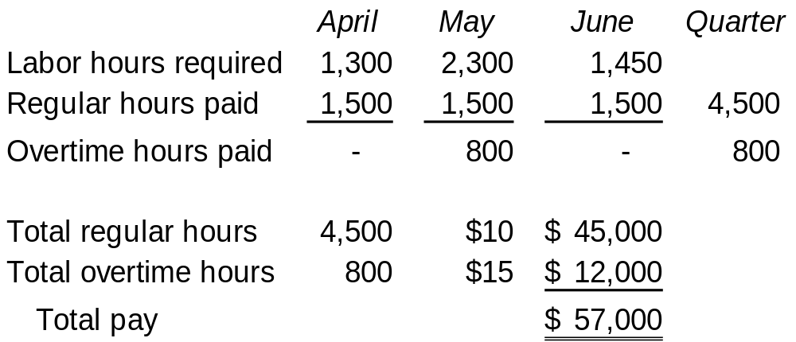
Quick Check ✓
What would be the total direct labor cost for the quarter if the company follows its no lay-off policy, but pays $15 (time-and-a-half) for every hour worked in excess of 1,500 hours in a month?
  a. $79,500
  b. $64,500
  c. $61,000
  d. $57,000
Notes:
How did you do? Did you get the correct answer of $57,000? The table on the right shows the detail computations.

Slide 72
Learning Objective 6
Prepare a manufacturing overhead budget.
Notes:
Learning objective number 6 is to prepare a manufacturing overhead budget.

Slide 73
Manufacturing Overhead Budget
At Royal, manufacturing overhead is applied to units of product on the basis of direct labor hours.
The variable manufacturing overhead rate is $20 per direct labor hour.
Fixed manufacturing overhead is $50,000 per month, which includes $20,000 of noncash costs (primarily depreciation of plant assets).
Let’s prepare the manufacturing overhead budget.
Notes:
Royal applies overhead on the basis of direct labor hours. The variable manufacturing overhead rate is $20 per direct labor hour. The fixed manufacturing overhead is $50,000 per month, of which $25,000 is noncash costs, primarily depreciation on the factory assets. This budget will provide a schedule of all costs of production other than direct materials and direct labor.

Slide 74
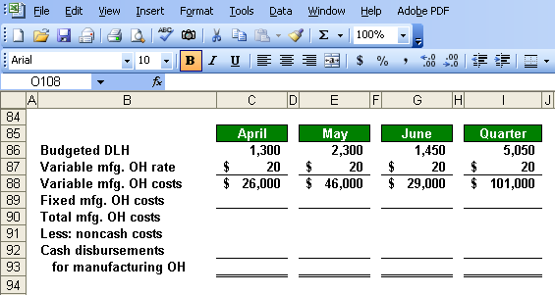
Manufacturing Overhead Budget
Direct Labor Budget.
Notes:
The first step in preparing the manufacturing overhead budget is to calculate the variable manufacturing overhead costs for each month and in total. We begin by multiplying our variable manufacturing overhead rate of $20 times the number of direct labor hours used in the month. For April, we expect to apply $26,000 of variable overhead.

Slide 75
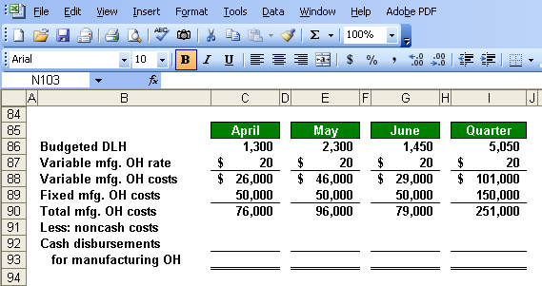
Manufacturing Overhead Budget
Total mfg. OH for quarter $251,000
Total labor hours required 5,050
= $49.70 per hour *
* rounded
Notes:
The second step is to add the fixed manufacturing overhead costs ($50,000 per month) to the variable overhead costs to arrive at total manufacturing overhead costs for each month and in total. We estimate total overhead of $76,000 in April and for the quarter, we expect a total of $251,000.
If we divide the manufacturing overhead of $251,000 by the total labor hours required during the quarter, we get a predetermined overhead rate of $49.70 (rounded). Once the level of fixed costs has been determined in the budget, the costs really are fixed; hence, the time to adjust fixed costs is during the budgeting process.

Slide 76
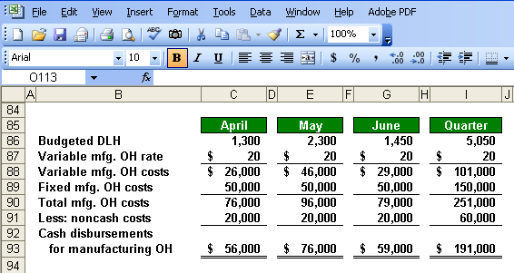
Manufacturing Overhead Budget
Depreciation is a noncash charge.
Notes:
The third step is to calculate the cash disbursements for manufacturing overhead by subtracting noncash expenses from the total manufacturing overhead costs. When we subtract the noncash overhead costs from the total manufacturing overhead costs, we get the cash paid for overhead costs. We will use this cash overhead amount in our cash budget. In our example, $20,000 of depreciation is deducted from each month’s total overhead costs to arrive at the cash disbursements for manufacturing overhead.

Slide 77
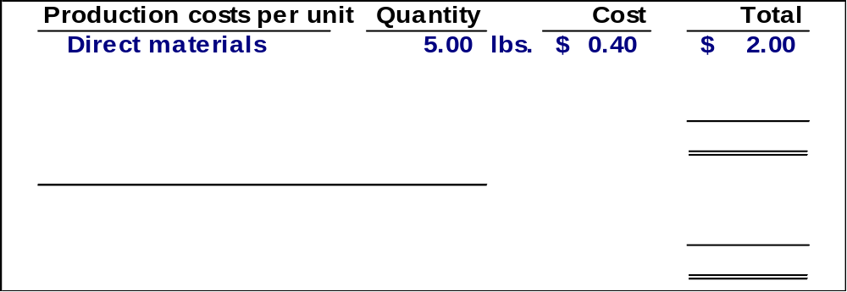
Ending Finished Goods Inventory Budget
Direct materials
budget and information.
Notes:
Royal can now complete the ending finished goods inventory budget. The first step in preparing this budget is to compute direct materials cost per unit. We know that each unit requires 5 pounds of direct material at $0.40 per pound, for a total of $2.00 per unit. The information needed can be derived by referring back to the direct materials budget.

Slide 78
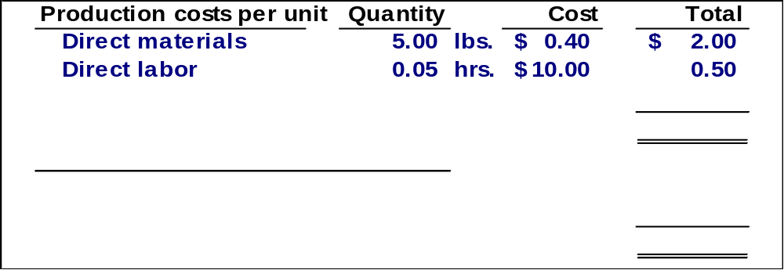
Ending Finished Goods Inventory Budget
Direct labor budget.
Notes:
The second step is to compute the direct labor cost per unit. It takes 0.05 hours to produce one unit and the pay rate is $10 per hour. We have a direct labor cost per unit of $0.50. The information needed can be derived by referring back to the direct labor budget.

Slide 79
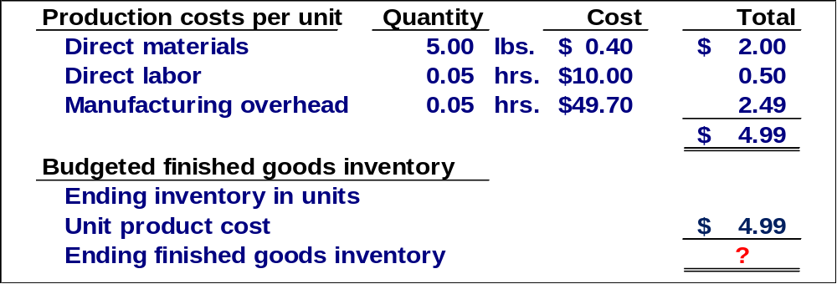
Ending Finished Goods Inventory Budget
Total mfg. OH for quarter $251,000
Total labor hours required 5,050
= $49.70 per hour
Notes:
The third step is to compute the manufacturing overhead cost per unit. Royal uses absorption costing for valuing inventory. We apply overhead on the basis of direct labor hours, so we multiply 0.05 times the predetermined rate of $49.70, which yields an overhead cost per unit of $2.49. Our total unit cost is $4.99. The predetermined overhead rate was calculated when we prepared the manufacturing overhead budget.
Next, we will calculate the cost of our ending finished goods inventory.

Slide 80
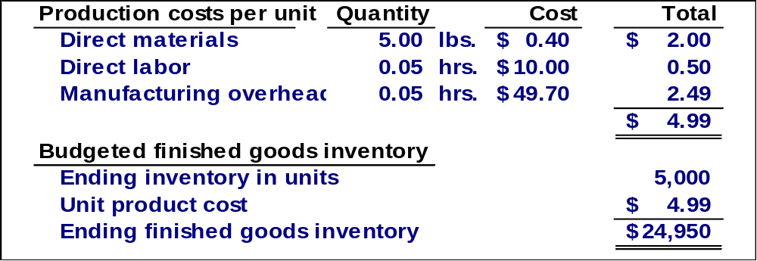
Ending Finished Goods Inventory Budget
Production Budget.
Notes:
The fourth step is to calculate the value of the ending finished goods inventory. We estimate there will be 5,000 units in ending inventory and at a per unit cost of $4.99, we have a total cost of $24,950. The finished goods inventory will appear on our budgeted balance sheet. The ending inventory in units is derived from the production budget.

Slide 81
Learning Objective 7
Prepare a selling and administrative expense budget.
Notes:
Learning objective number 7 is to prepare a selling and administrative expense budget.

Slide 82
Selling and Administrative Expense Budget
At Royal, the selling and administrative expense budget is divided into variable and fixed components.
The variable selling and administrative expenses are $0.50 per unit sold.
Fixed selling and administrative expenses are $70,000 per month.
The fixed selling and administrative expenses include $10,000 in costs – primarily depreciation – that are not cash outflows of the current month.
Let’s prepare the company’s selling and administrative expense budget.
Notes:
Royal has a variable and fixed component to its selling and administrative (S & A) expenses. The company estimates variable selling and administrative expenses at $0.50 per unit sold. Fixed selling and administrative expenses are estimated at $70,000 per month. Of this amount, $10,000 are noncash expenses, primarily depreciation.
The selling and administrative expense budget will be prepared in a manner similar to our overhead budget. This budget lists the budgeted expenses for areas other than manufacturing and it is typically a compilation of many smaller individual budgets.

Slide 83
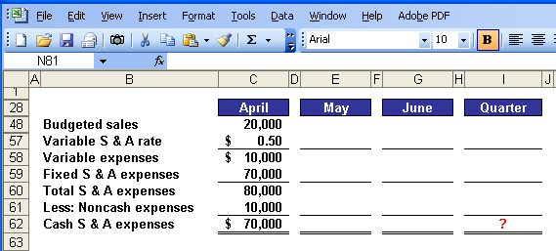
Selling and Administrative Expense Budget
Calculate the selling and administrative
cash expenses for the quarter.
Notes:
The first step in preparing this budget is to multiply the variable selling and administrative (S & A) rate by the number of units sold. In April, we expect to sell 20,000 units and apply the variable rate of $0.50 per unit.
The second step is to add in the fixed S & A expenses to arrive at total S & A expenses. To our variable expenses, we add our estimated $70,000 fixed selling and administrative expenses to get total selling and administrative expenses of $80,000.
The third step is to deduct noncash S & A expenses to arrive at cash disbursements for S & A expenses. Cash selling and administrative expenses for April of $70,000.
Take a few minutes to complete the schedule and see what kind of progress you are making.

Slide 84
Quick Check ✓
What are the total cash disbursements for selling and administrative expenses for the quarter?
  a. $180,000
  b. $230,000
  c. $110,000
  d. $ 70,000
Notes:
What are the total cash selling and administrative expenses for the quarter?

Slide 85
Quick Check ✓
What are the total cash disbursements for selling and administrative expenses for the quarter?
  a. $180,000
  b. $230,000
  c. $110,000
  d. $ 70,000
Notes:
Did you get $230,000? Let’s look at the schedule on the next screen and compare it to your work.

Slide 86
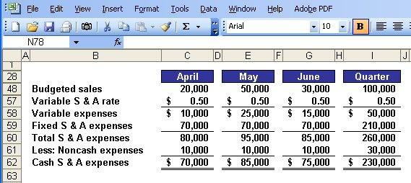
Selling Administrative Expense Budget
Notes:
The same steps are followed for the months of May and June to arrive at total cash disbursements for S & A expenses for the quarter of $230,000.

Slide 87
Learning Objective 8
Prepare a cash budget.
Notes:
Learning objective number 8 is to prepare a cash budget.

Slide 88
Format of the Cash Budget
The cash budget is divided into four sections:
Cash receipts section lists all cash inflows excluding cash received from financing;
Cash disbursements section consists of all cash payments excluding repayments of principal and interest;
Cash excess or deficiency section determines if the company will need to borrow money or if it will be able to repay funds previously borrowed; and
Financing section details the borrowings and repayments projected to take place during the budget period.
Notes:
The preparation of the cash budget can be quite complex. This budget should be broken down into time periods that are as short as feasible. It consists of four major sections:
Cash receipts section lists all cash inflows excluding cash received from financing;
Cash disbursements section consists of all cash payments excluding repayments of principal and interest;
Cash excess or deficiency section determines if the company will need to borrow money or if it will be able to repay funds previously borrowed; and
Financing section details the borrowings and repayments projected to take place during the budget period.

Slide 89
The Cash Budget
Assume the following information for Royal:
  Maintains a 16% open line of credit for $75,000
  Maintains a minimum cash balance of $30,000
  Borrows on the first day of the month and repays loans on the last day of the month
  Pays a cash dividend of $49,000 in April
  Purchases $143,700 of equipment in May and $48,300 in June (both purchases paid in cash)
  Has an April 1 cash balance of $40,000
Notes:
It would be a good idea to jot down this additional information or merely print the screen. We will need all of this information to prepare the cash budget.

Slide 90
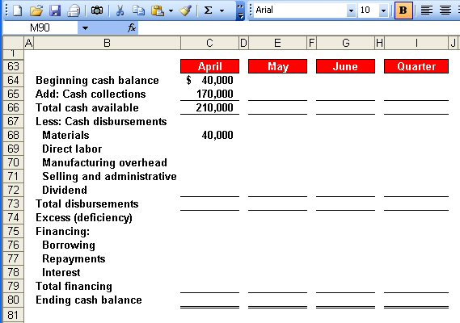
The Cash Budget
Schedule of Expected
Cash Collections.
Notes:
The first step in preparing this budget is to calculate the total cash available. We began April with $40,000 in cash. To this amount, we add our expected cash collections from sales of $170,000 for the month of April. We complete the first section by calculating the total cash available of $210,000.
Now, let’s continue with the budget preparation.

Slide 91
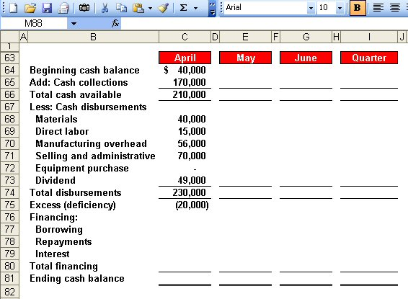
The Cash Budget
Schedule of Expected
Cash Disbursements.
Direct Labor
Budget.
Manufacturing
Overhead Budget.
Selling and Administrative
Expense Budget.
Notes:
The second step is to calculate the total cash disbursements. During April, we expect to pay $40,000 for raw materials, $15,000 for direct labor, $56,000 for cash manufacturing overhead, and $70,000 for selling and administrative expense. This is not the total manufacturing overhead because we have excluded noncash depreciation costs.
During April, the Board of Directors paid a cash dividend of $49,000.
We have now completed the second major section of the cash budget, the cash disbursements.

Slide 92
The Cash Budget
Because Royal maintains
a cash balance of $30,000,
the company must borrow $50,000 on its line-of-credit.
Notes:
The third step is to calculate the excess (deficiency) of cash available over disbursements. In the month of April, we expect to have a cash deficiency of $20,000, given that Royal has a policy that the company will always maintain an ending cash balance of $30,000.

Slide 93
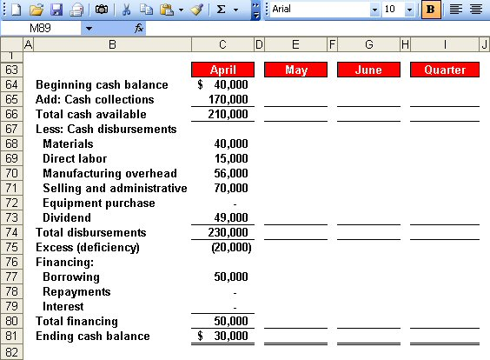
The Cash Budget
Because Royal maintains
a cash balance of $30,000,
the company must borrow $50,000 on its line-of-credit.
Ending cash balance for April
is the beginning May balance.
Notes:
The fourth step is to determine the financing requirements and the ending cash balance. After Royal borrows $50,000 on its line-of-credit, it will have an ending cash balance of $30,000. The ending cash balance for April becomes the beginning cash balance for May.
Let’s complete the cash budget for the month of May.

Slide 94
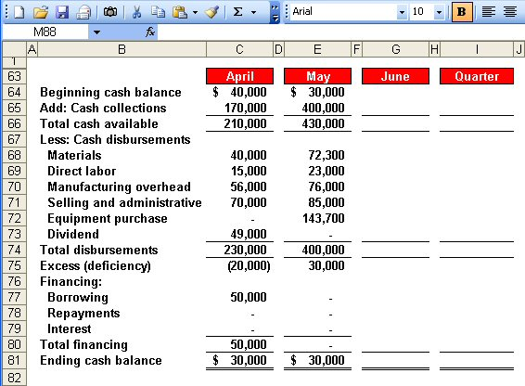
The Cash Budget
Notes:
These four steps are repeated for the month of May. The result is a $30,000 excess of cash available over disbursements. Since Royal must maintain a minimum cash balance of $30,000 it will not repay any of its loan in May.

Slide 95
Quick Check ✓
What is the excess (deficiency) of cash available over disbursements for June?
  a. $ 85,000
  b. $(10,000)
  c. $ 75,000
  d. $ 95,000
Notes:
Now, it’s your turn to calculate the cash excess or deficiency for the month of June. Which amount did you determine to be correct?

Slide 96
Quick Check ✓
What is the excess (deficiency) of cash available over disbursements for June?
  a. $ 85,000
  b. $(10,000)
  c. $ 75,000
  d. $ 95,000
Notes:
$95,000 is the correct answer. Let’s look at the completed schedule on the next screen.

Slide 97
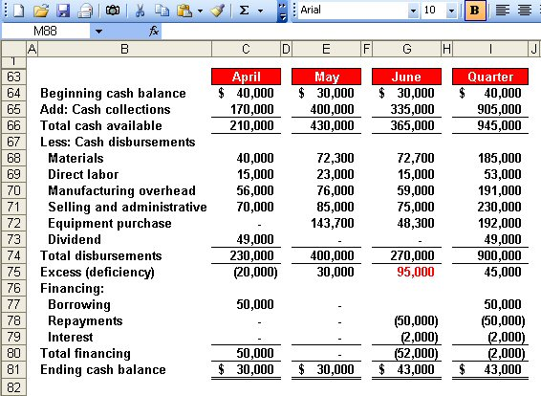
The Cash Budget
$50,000 × 16% × 3/12 = $2,000
Borrowings on April 1 and
repayment on June 30.
Notes:
The same four steps are repeated for June. The result is an excess of cash available of $95,000.
At the end of June, Royal will have sufficient cash to repay the $50,000 borrowed in April plus the interest on the loan. The total interest is $2,000 as demonstrated in the computation of interest box on the left side of your screen.
Royal will end the quarter with $43,000 cash on hand. This cash balance will appear on our budgeted balance sheet.

Slide 98
The Budgeted Income Statement
Cash
Budget
Budgeted
Income
Statement
Completed
With interest expense from the cash budget, Royal can prepare the budgeted income statement.
Notes:
We are now ready to move from the preparation of individual budgets to preparing our budgeted financial statements. The cash budget must be prepared first so that the interest expense can be determined for the budgeted income statement. Let’s begin with the budgeted income statement.

Slide 99
Learning Objective 9
Prepare a budgeted income statement.
Notes:
Learning objective number 9 is to prepare a budgeted income statement.

Slide 100
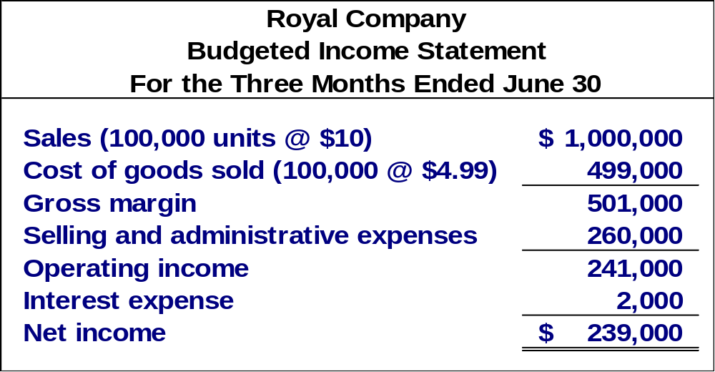
The Budgeted Income Statement
Sales Budget.
Ending Finished
Goods Inventory.
Selling and
Administrative
Expense Budget.
Cash Budget.
Notes:
The numbers for the budgeted income statement come from other budgets that have already been prepared. More specifically, the sales revenue comes from the sales budget. The cost of goods sold, on a per unit basis comes from the ending finished goods inventory budget. The selling and administrative expenses come from the S & A budget. The interest expense comes from the cash budget. Royal calculates budgeted net income for the quarter is $239,000.
With the income statement complete, we can move on to the budgeted balance sheet.

Slide 101
Learning Objective 10
Prepare a budgeted balance sheet.
Notes:
Learning objective number 10 is to prepare a budgeted balance sheet.

Slide 102
The Budgeted Balance Sheet
Royal reported the following account balances prior to preparing its budgeted financial statements:
  Land - $50,000
  Common stock - $200,000
  Retained earnings - $146,150 (April 1)
  Equipment - $175,000
Notes:
Please make note of this supplemental information as we will need it to complete the budgeted balance sheet.

Slide 103
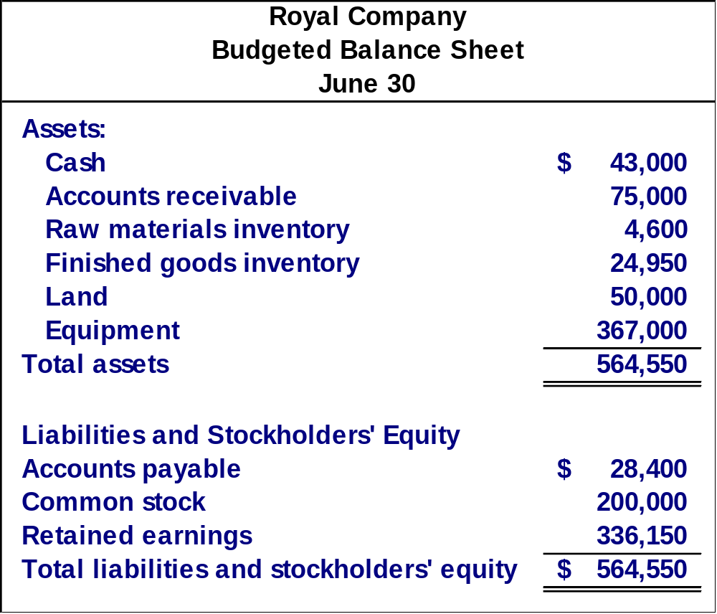
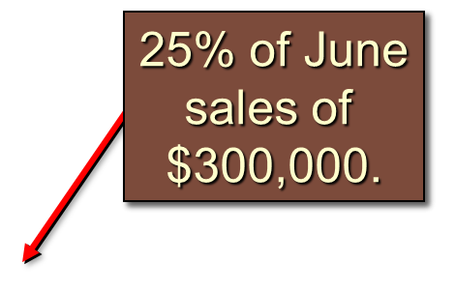
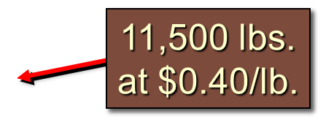
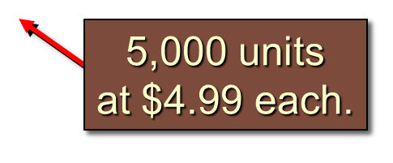
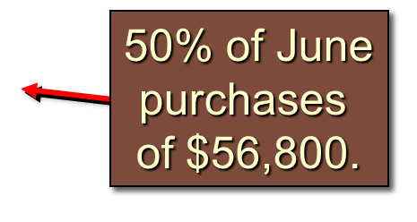
Notes:
You can see our cash balance of $43,000 comes directly from the cash budget. Accounts receivable ($75,000) is 25% of June’s sales ($300,000). Raw materials inventory ($4,600) is calculated by multiplying the ending inventory of raw material in pounds (11,500) by the cost per pound. The finished goods inventory ($24,950) is taken from the ending finished goods inventory budget. The land and equipment amounts are given. Accounts payable ($28,400) is 50% of June’s purchases ($56,800). The balance in the common stock account is given.

Slide 104
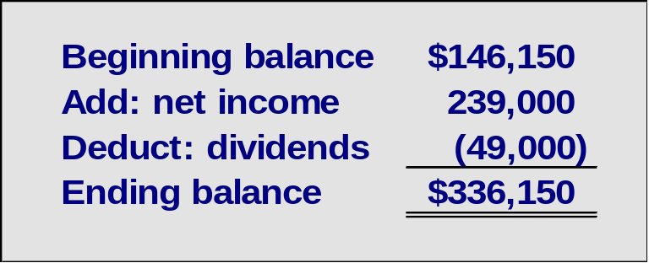
Notes:
The balance of retained earnings at June 30 is $336,150, which is based on: beginning balance + net income - dividends paid ($146,150 + $239,000 - $49,000).

